Slide 1


WATER QUALITY PREDICTION

Slide 2

Learning Objectives:
- Understand data preprocessing for water quality dataset.
- Apply ML algorithms for classification/prediction.
- Evaluate model performance using accuracy metrics.
GOAL:
- To predict water quality based on key parameters. : - - Build a model that predicts a composite Water Quality Index (WQI) 24 hours ahead with MAE ≤ 5 WQI points on test data.
Source :
www.freepik.com/

Slide 3
Tools and Technology used
Python
- Pandas, NumPy
- Matplotlib, Seaborn
- Scikit-learn
- Jupyter Notebook / Google Colab

Slide 4
Methodology :
1. Data Collection
2. Data Cleaning & Preprocessing
3. Feature Selection
4. Model Building (Random Forest, Logistic Regression, etc.)
5. Model Evaluation
6. Prediction of Water Quality

Slide 5
Problem Statement:
.1. Data Collection
.2. Data Cleaning & Preprocessing
.3. Feature Selection
.4. Model Building (Random Forest, Logistic Regression, etc.)
.5. Model Evaluation
.6. Prediction of Water Quality

Slide 6
Solution:
-Develop a machine learning model that:
- Analyzes water quality parameters.
- Predicts whether water is safe for drinking.
- Provides quick and accurate predictions.

Slide 7
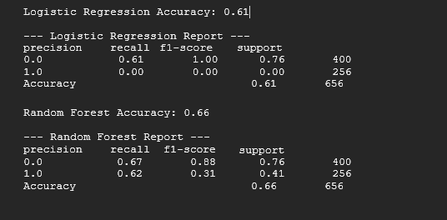
Screenshot of Output:

Slide 8
Conclusion:
- Machine learning can effectively predict water quality.
- Saves time and reduces manual testing effort.
- Helps in ensuring safe drinking water.
- Future work: Deploy as a web or mobile application.

